Slide 1
What’s New in .NET MAUI

Slide 2
.NET MAUI

Slide 3

.NET Multi-platform App UI (MAUI)
Single project system, single codebase
macOS
iOS
WinUI
Mac Catalyst
iOS
Android
Notes:
MAUI is our unified platform for -

Slide 4









Build anything with a unified platform
.NET
Cloud
Web
Desktop
Mobile
Gaming
IoT
AI
+
+
Visual Studio
Visual Studio Code
CLI
Linux
NuGet
Github
Components, tools, library vendors
Windows
macOS
Tools
Operating system
Ecosystem
Notes:
MAUI is part of .NET

Slide 5
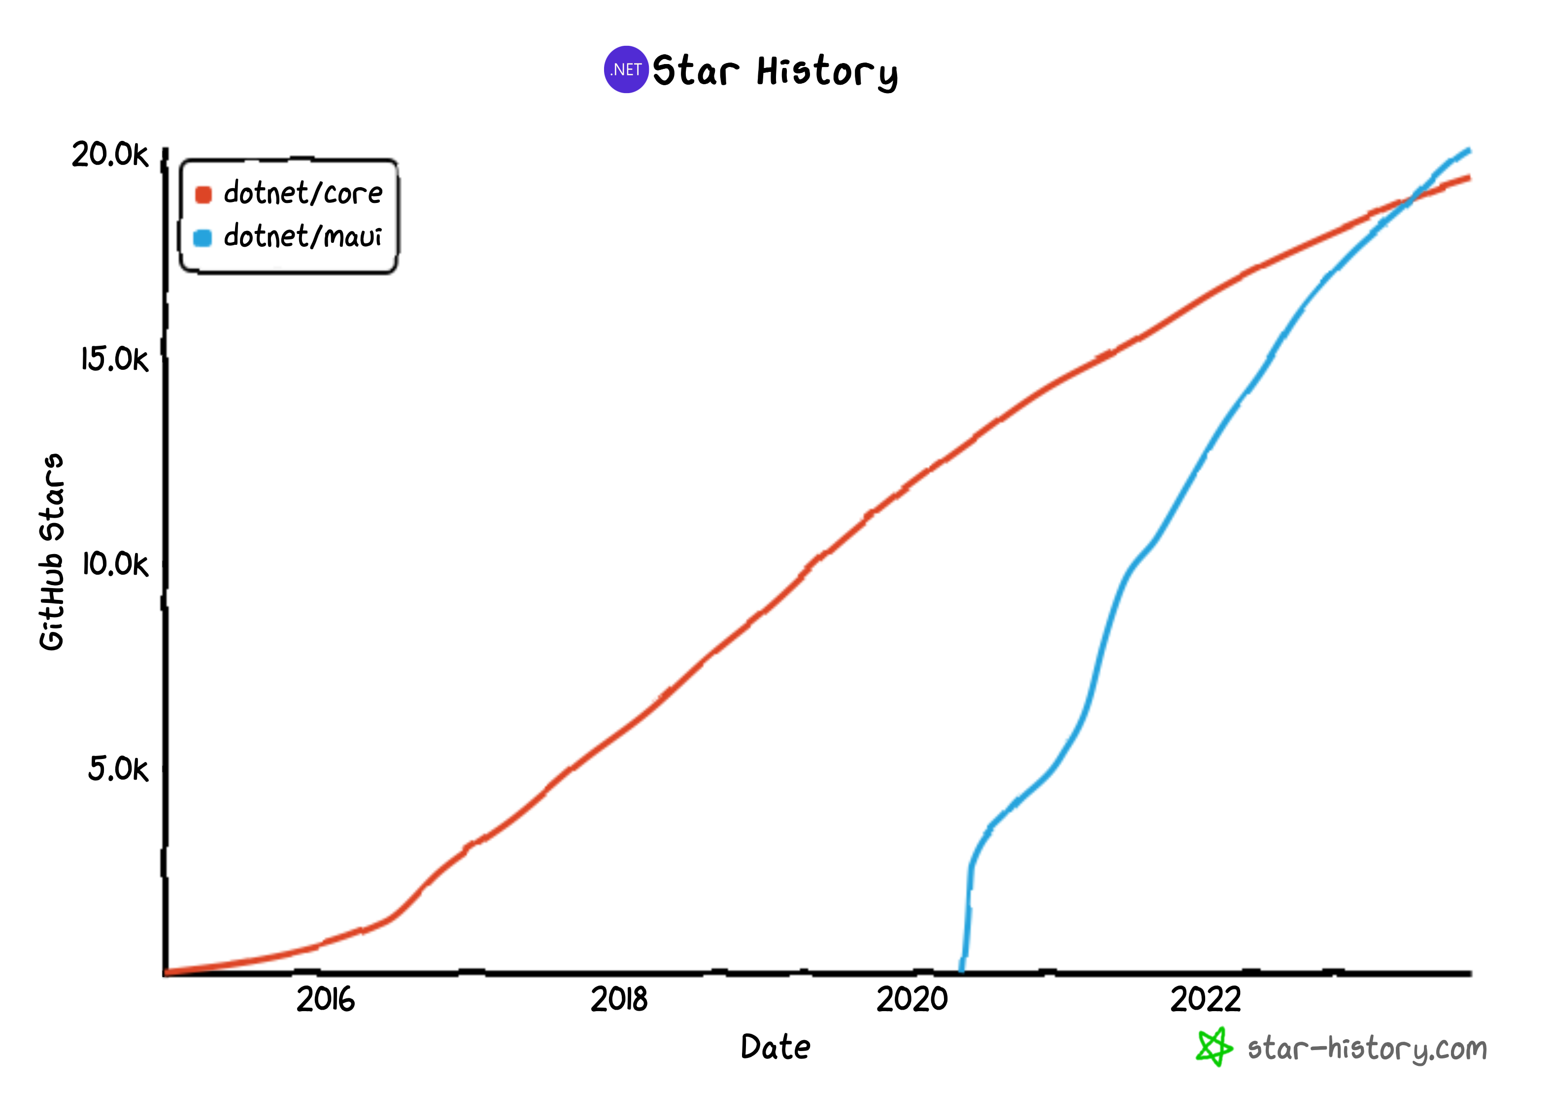
Hello, .NET 8 MAUI!
Top 2
Top 2
Active GitHub users in dotnet
Most active in
.NET Foundation
Top 5
Most active C# repo on GitHub October 2023
1600+ PRs and 600+ Issues Closed in .NET 8
github.com/dotnet/maui
Notes:
We have a ton of people involved in making maui amazing thank you for keeping up the momentum

Slide 6



























Notes:
Not only are we active on github but we have lots of great customers using MAUI already to build their apps

Slide 7
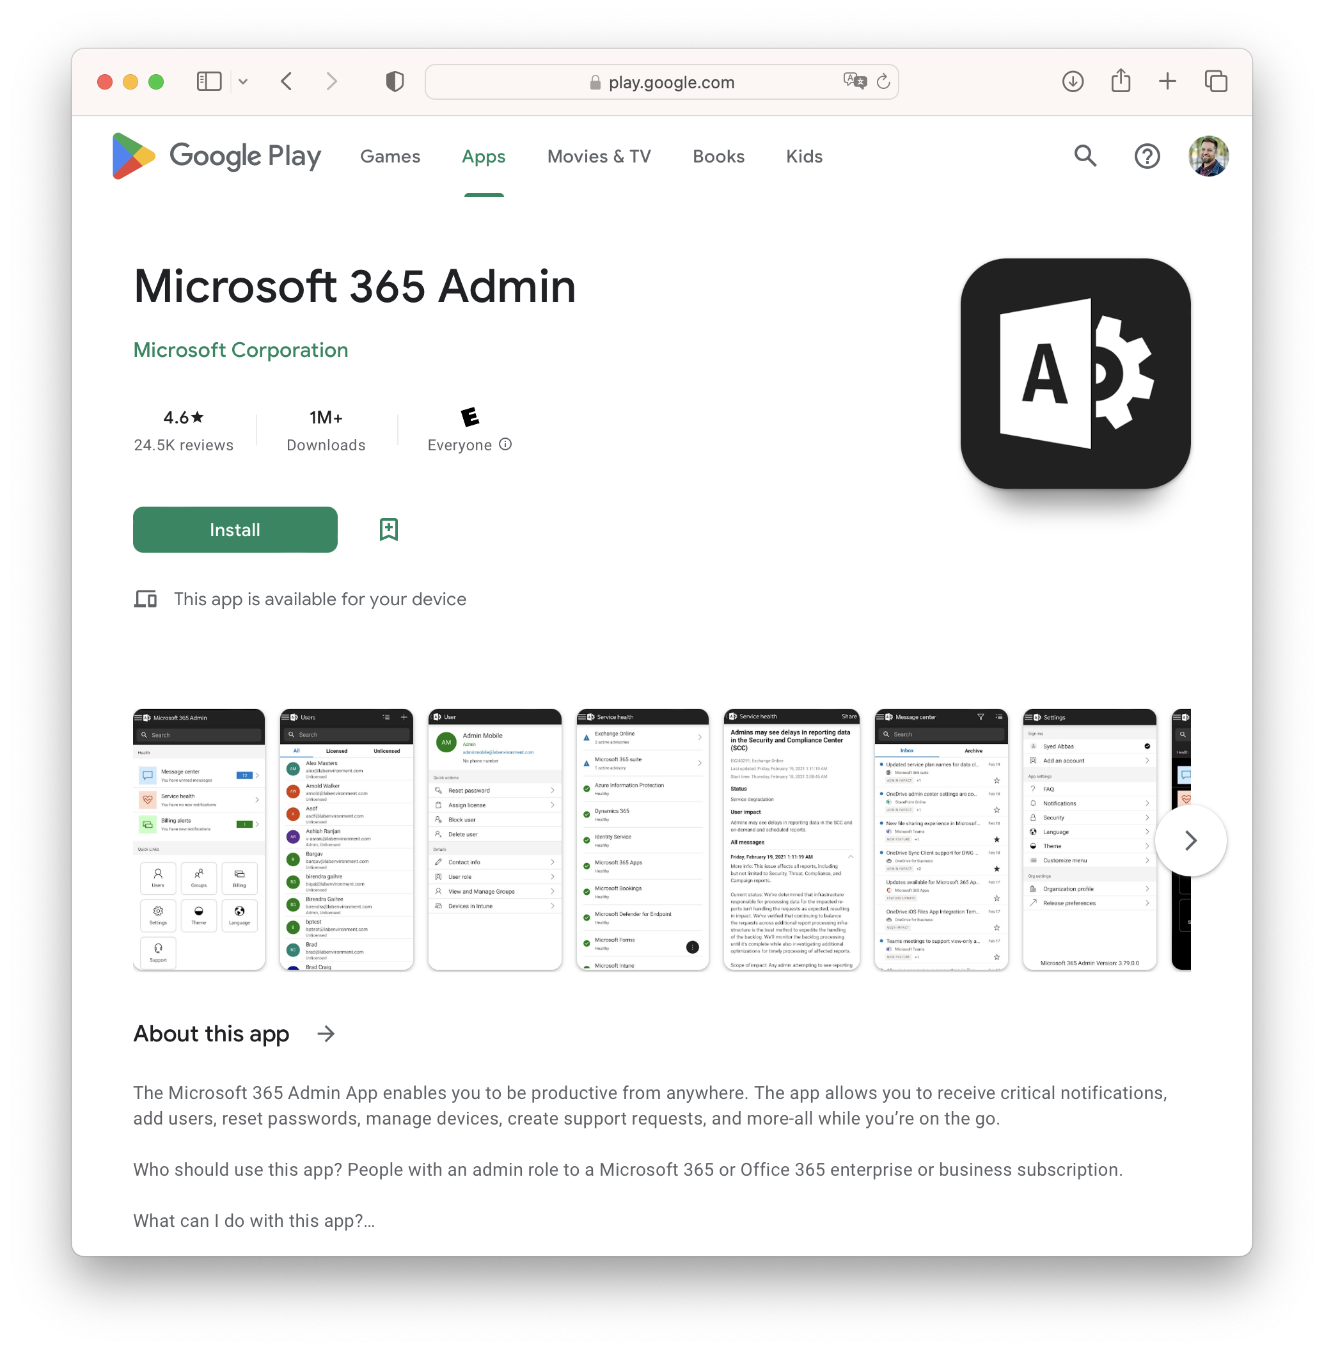
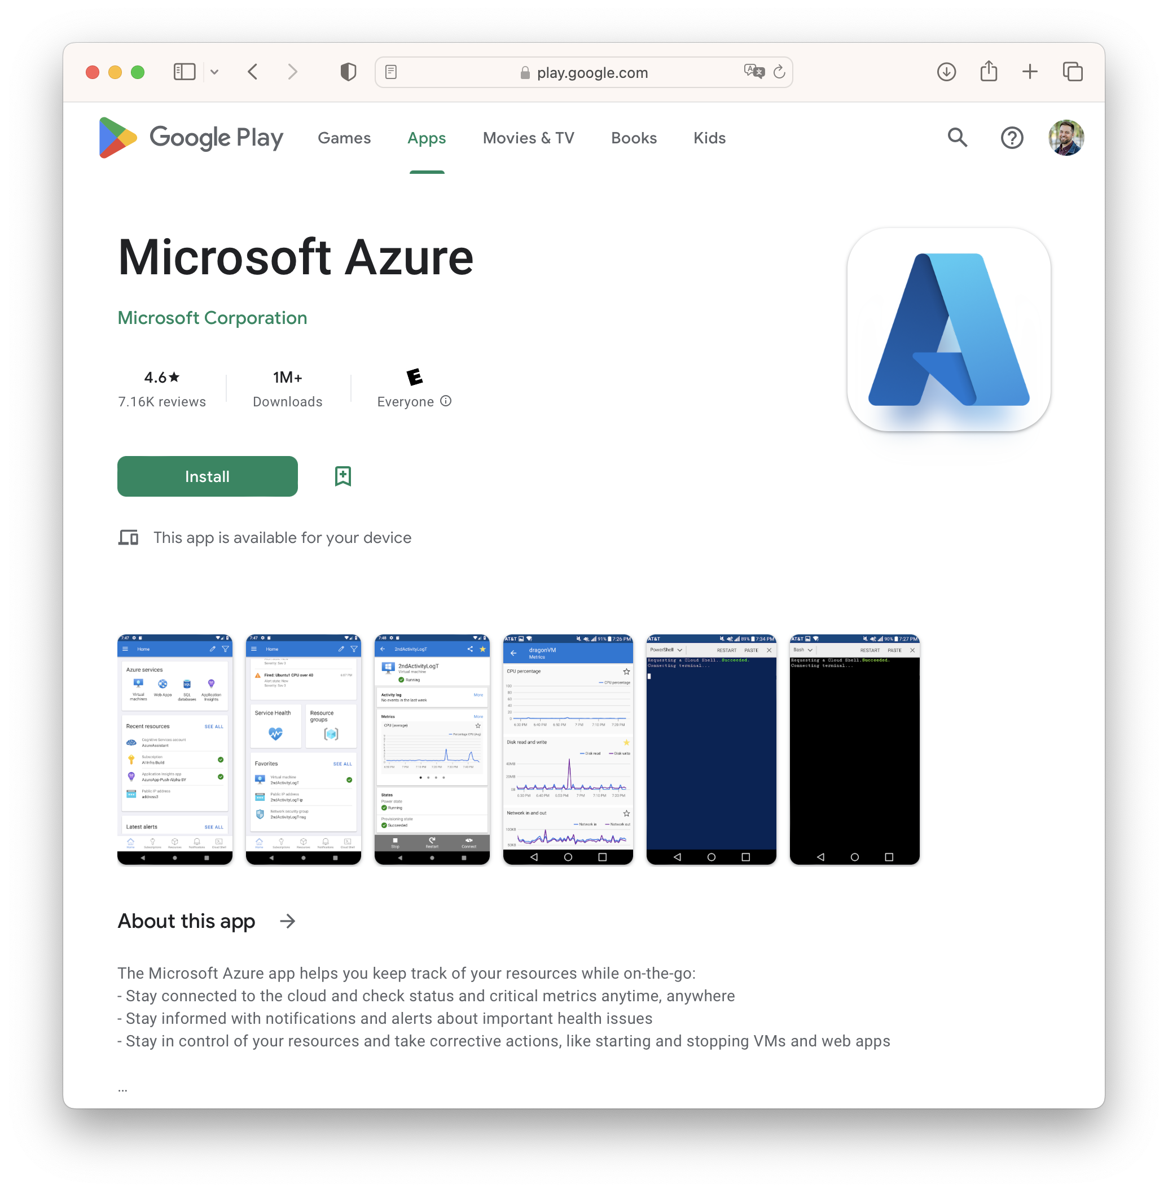
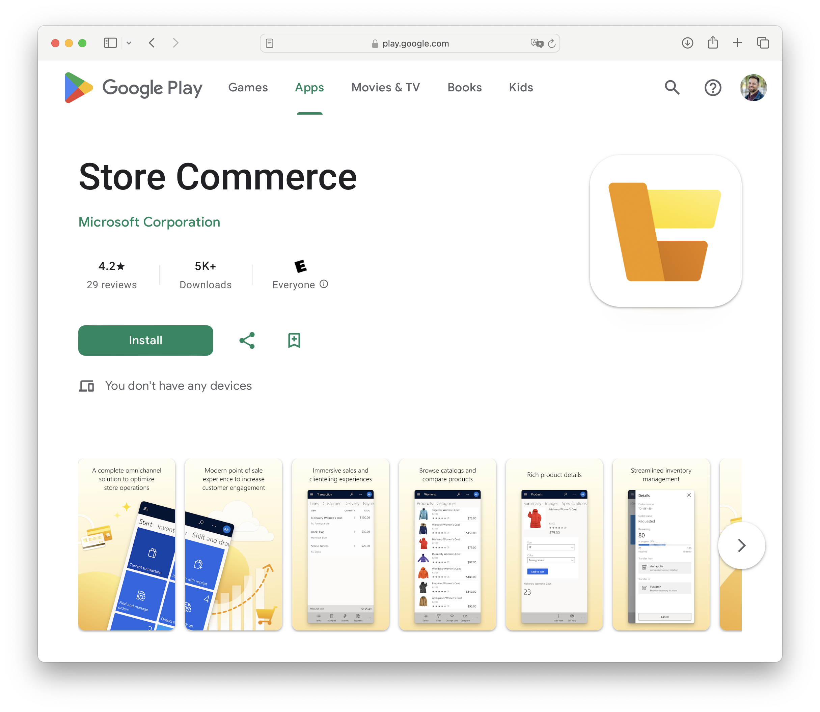
.NET MAUI at Microsoft
Notes:
And one question we hear a lot – yes Microsoft uses it

Slide 8
.NET MAUI in .NET 8

Slide 9
.NET MAUI in .NET 8
Improved performance and memory management
New hybrid and desktop app features
Flexible tooling for development
Tons of bug fixes and stability work
dot.net/maui

Slide 10
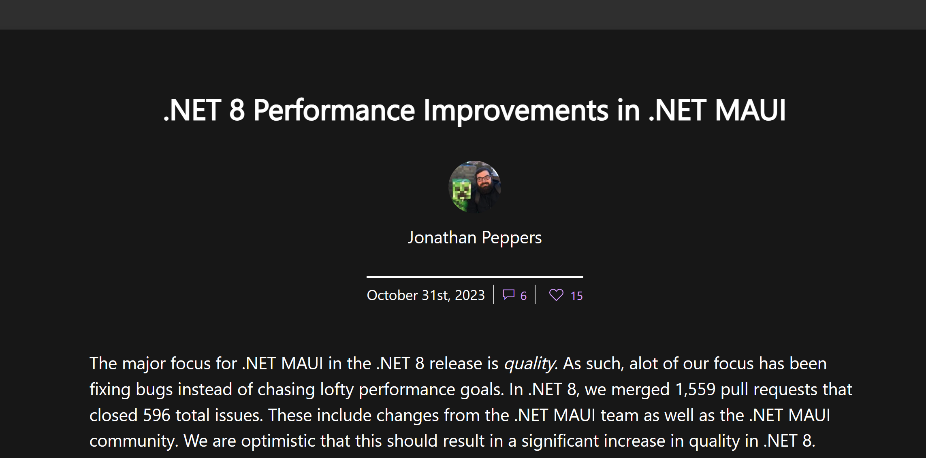

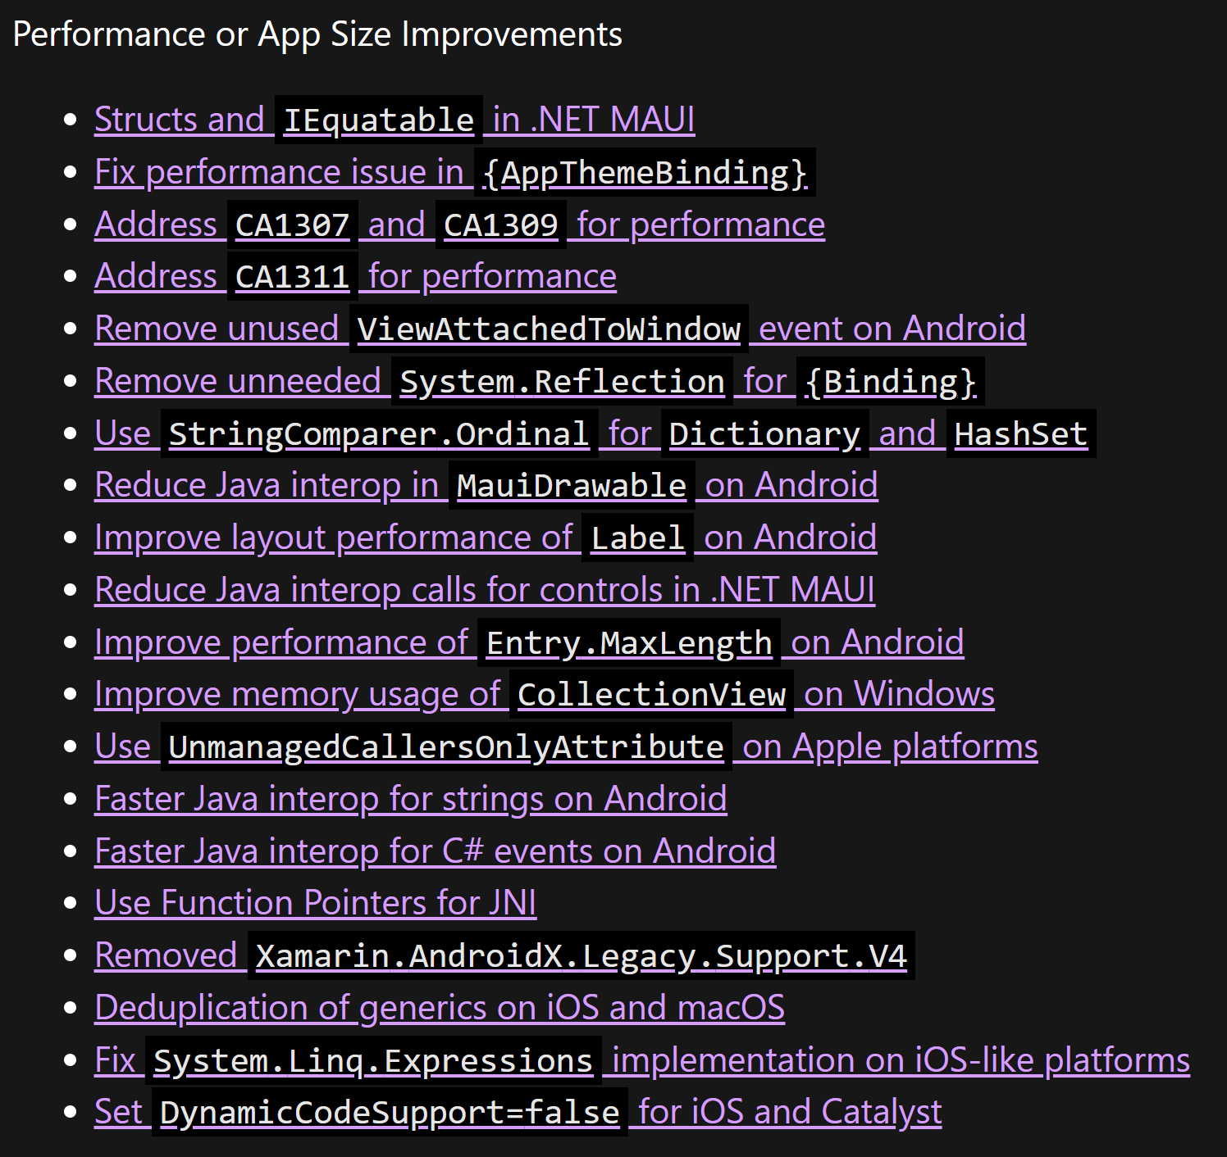
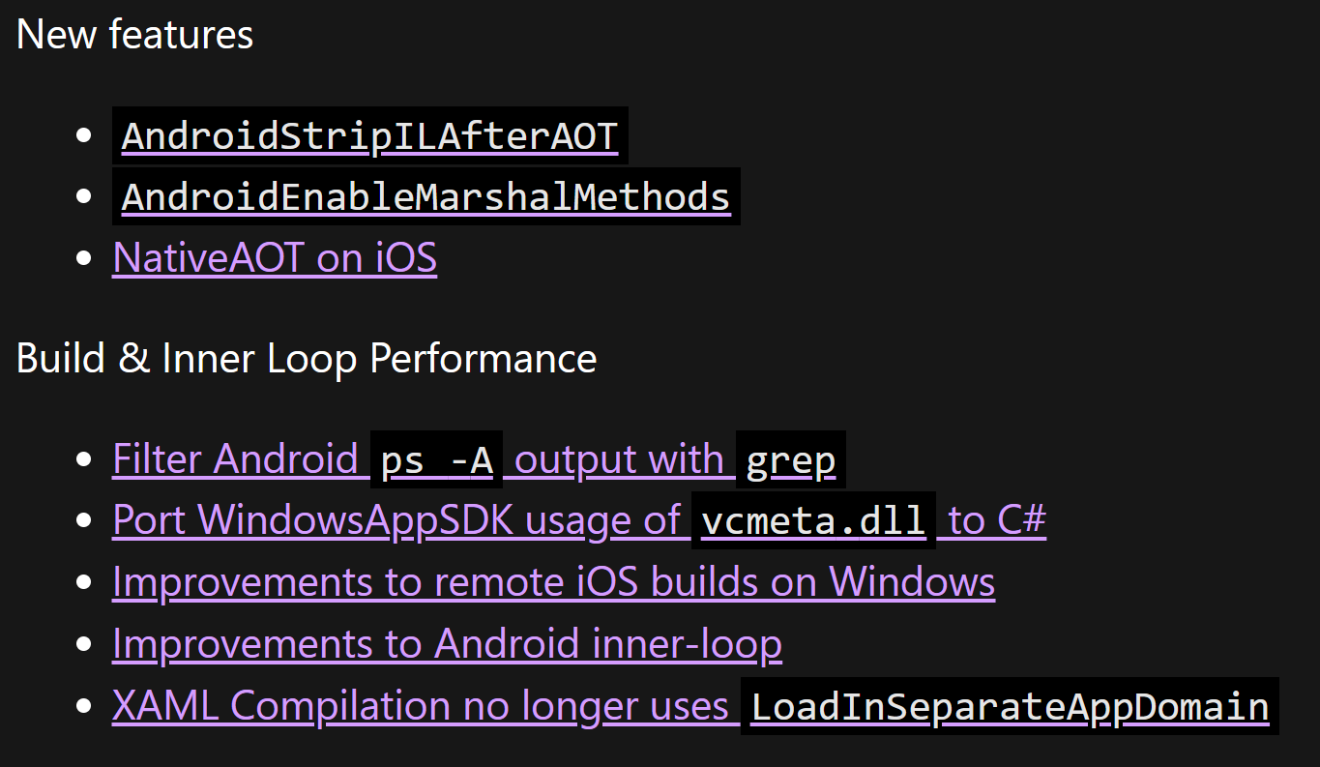
Notes:
Tons of perf improvements, go see peppers talk from earlier or read the blog

Slide 11
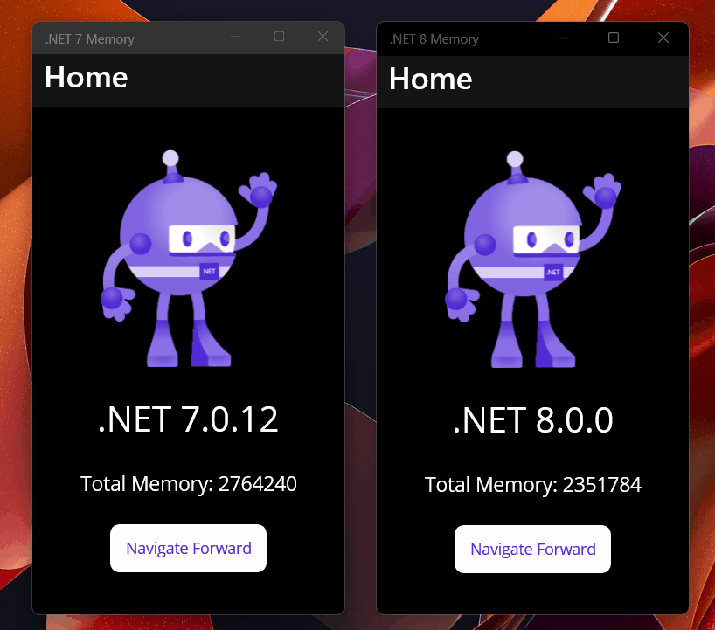
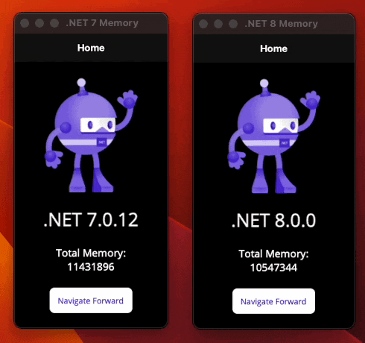
GC.GetTotalMemory(): .NET 7 vs .NET 8
Notes:
We really focused in on memory leaks – for all platforms

Slide 12

.NET offers choice for developers
BLAZOR
C#, HTML, CSS
BLAZOR + .NET MAUI
.NET MAUI
C#, XAML
Reach
Depth
Websites and PWAs
Hybrid
Native
Notes:
Performance is fun and all but we also worked on some areas you told us to focus on – namely hybrid and desktop app functionality!

Slide 13


Blazor hybrid apps
Native app container & embedded controls
Fully native web UI through platform WebView
Multi-platform with MAUI abstractions
No internet required
Store distribution and reach
Blazor
Razor Components
BlazorWebView
.NET MAUI
Native APIs
WinUI
Mac
Catalyst
iOS
Android
macOS
iOS
Notes:
We’ve seen lots of people adopting blazor hybrid, so we’ve continued to work with our friends over there to refine the experience

Slide 14
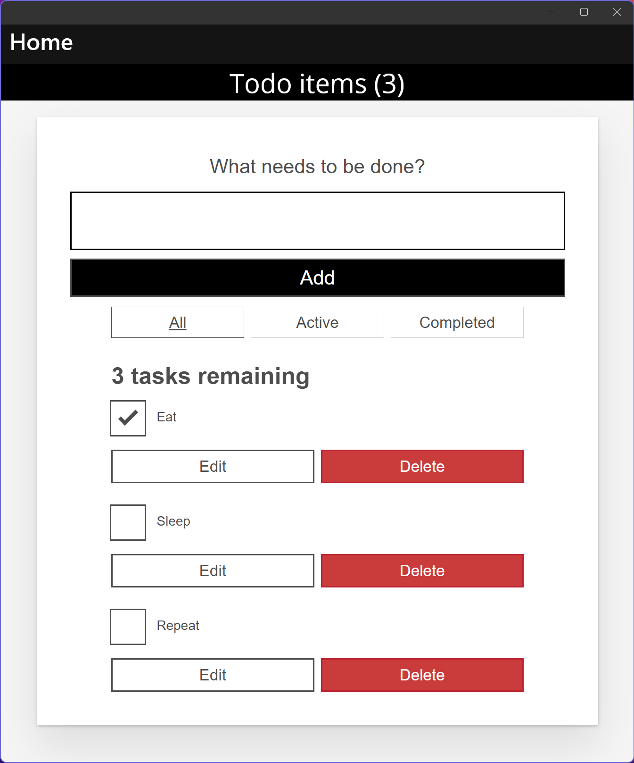
.NET MAUI HybridWebView Experiment
Multi-platform control based on .NET MAUI WebView
Host static web assets (HTML, JS, CSS, etc.)
Communicate between JavaScript & .NET
Reuse your Angular, React, etc. investments in MAUI native desktop and mobile apps
Use any web-based UI and it can interact with C# code
Native app container & controls
Hybrid WebView React JS
Notes:
And we’re experimenting outside of blazor – what if you could run react or other javascript UI natively in .net with maui?!

Slide 15
Desktop Development
.NET 7
.NET 8
Tooltips
Pointer hover
Right-click & context menus
Custom keyboard accelerators
Drag and drop gestures
Pointer gestures for pressed & released

Slide 16
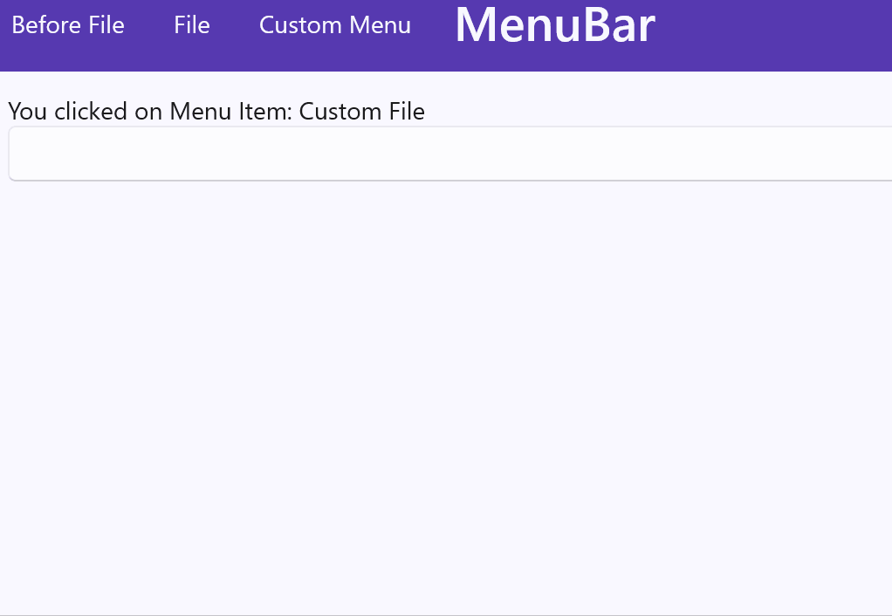
Keyboard Accelerators
<MenuFlyoutItem Text=”Custom File">
<MenuFlyoutItem.KeyboardAccelerators>
<KeyboardAccelerator Key=”F" Modifiers=”Ctrl">
</MenuFlyoutItem.KeyboardAccelerators>
</MenuFlyoutItem>

Slide 17
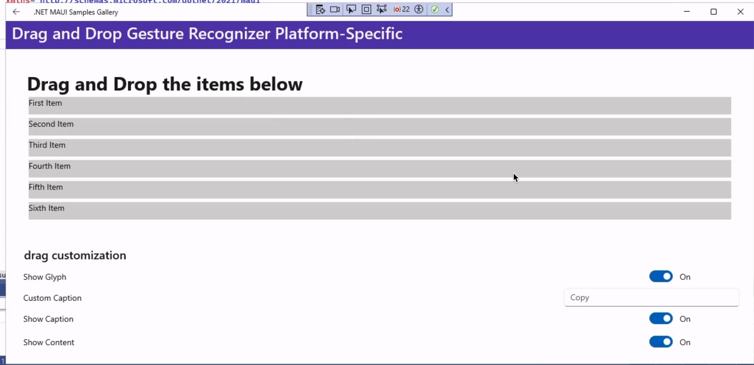
Drag & Drop
Exposed WinUI Drag & Drop APIs such as custom glyphs (images) and captions on drag

Slide 18
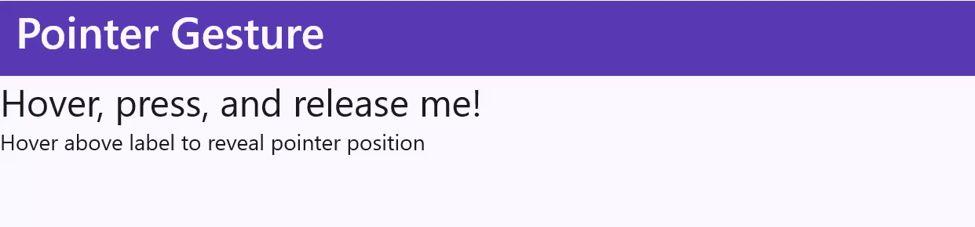
Pointer Gestures
PointerPressed and PointerReleased

Slide 19
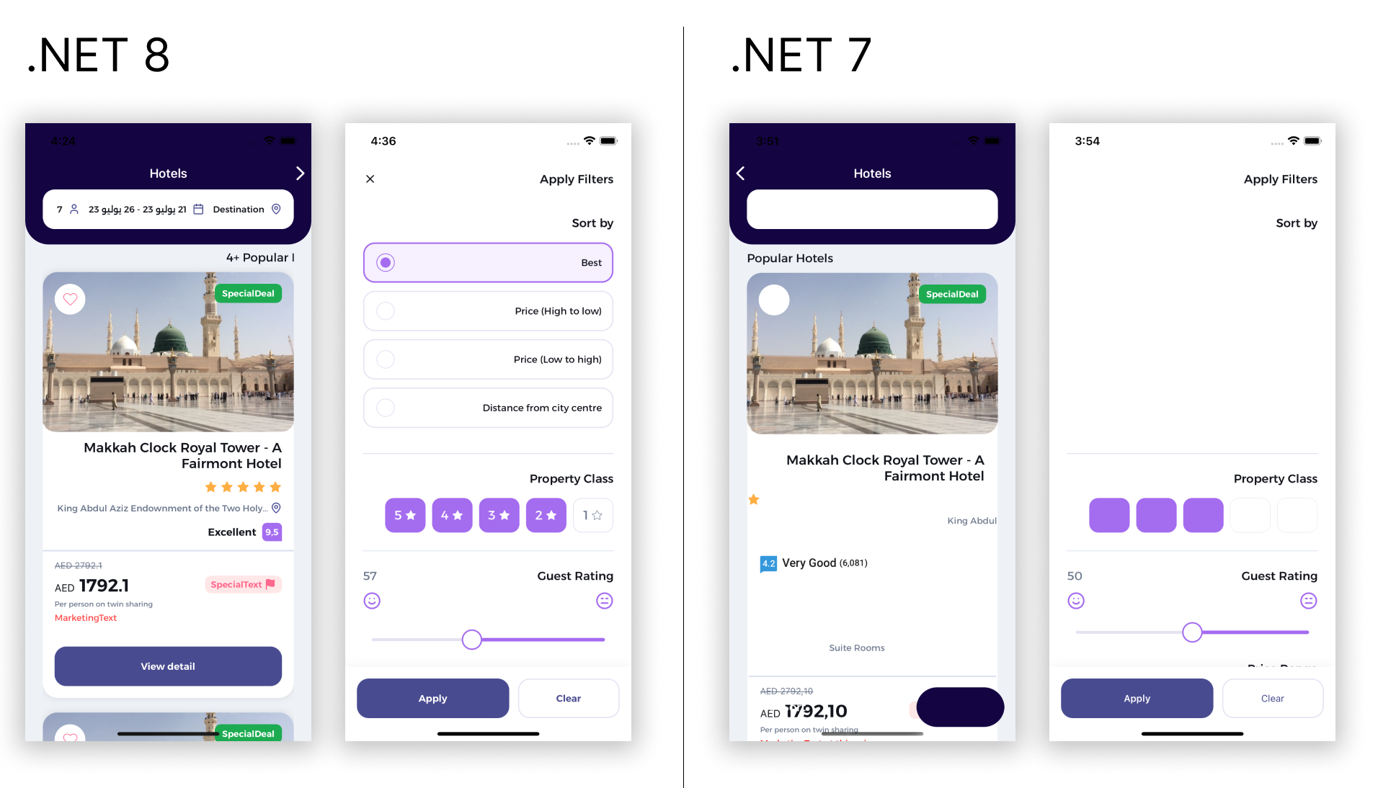
Right-to-left (RTL) Improvements
“Creating Right to Left layouts in .NET MAUI is now a reality thanks to .NET 8. Visual elements are perfectly arranged and Carousels work great now.”
– Leo, UX Divers
Notes:
DAVE

Slide 20
Last but not least
Fixes related to…
CollectionView
TabBar visibility
RoundRectangle Borders
Android text alignment
Drag-and-drop functionality
Tab bar appearance
CheckBox
RefreshView
SwipeItem
Label
Button
Border clipping
Window glitches
Image loading problems
Cursor preservation in text boxes
Menu key accelerators
InputTransparent behavior permutations
Fonts
Navigation
Tabs
File picker
Entry visibility under keyboard
iOS SafeArea
Downscaled iOS images
Removal of Rosetta
Unpackaged WinUI apps
Width & Height requests
Platform consistency
NREs & crashes
…and much more!!!
Notes:
DAVE

Slide 21
Tooling

Slide 22
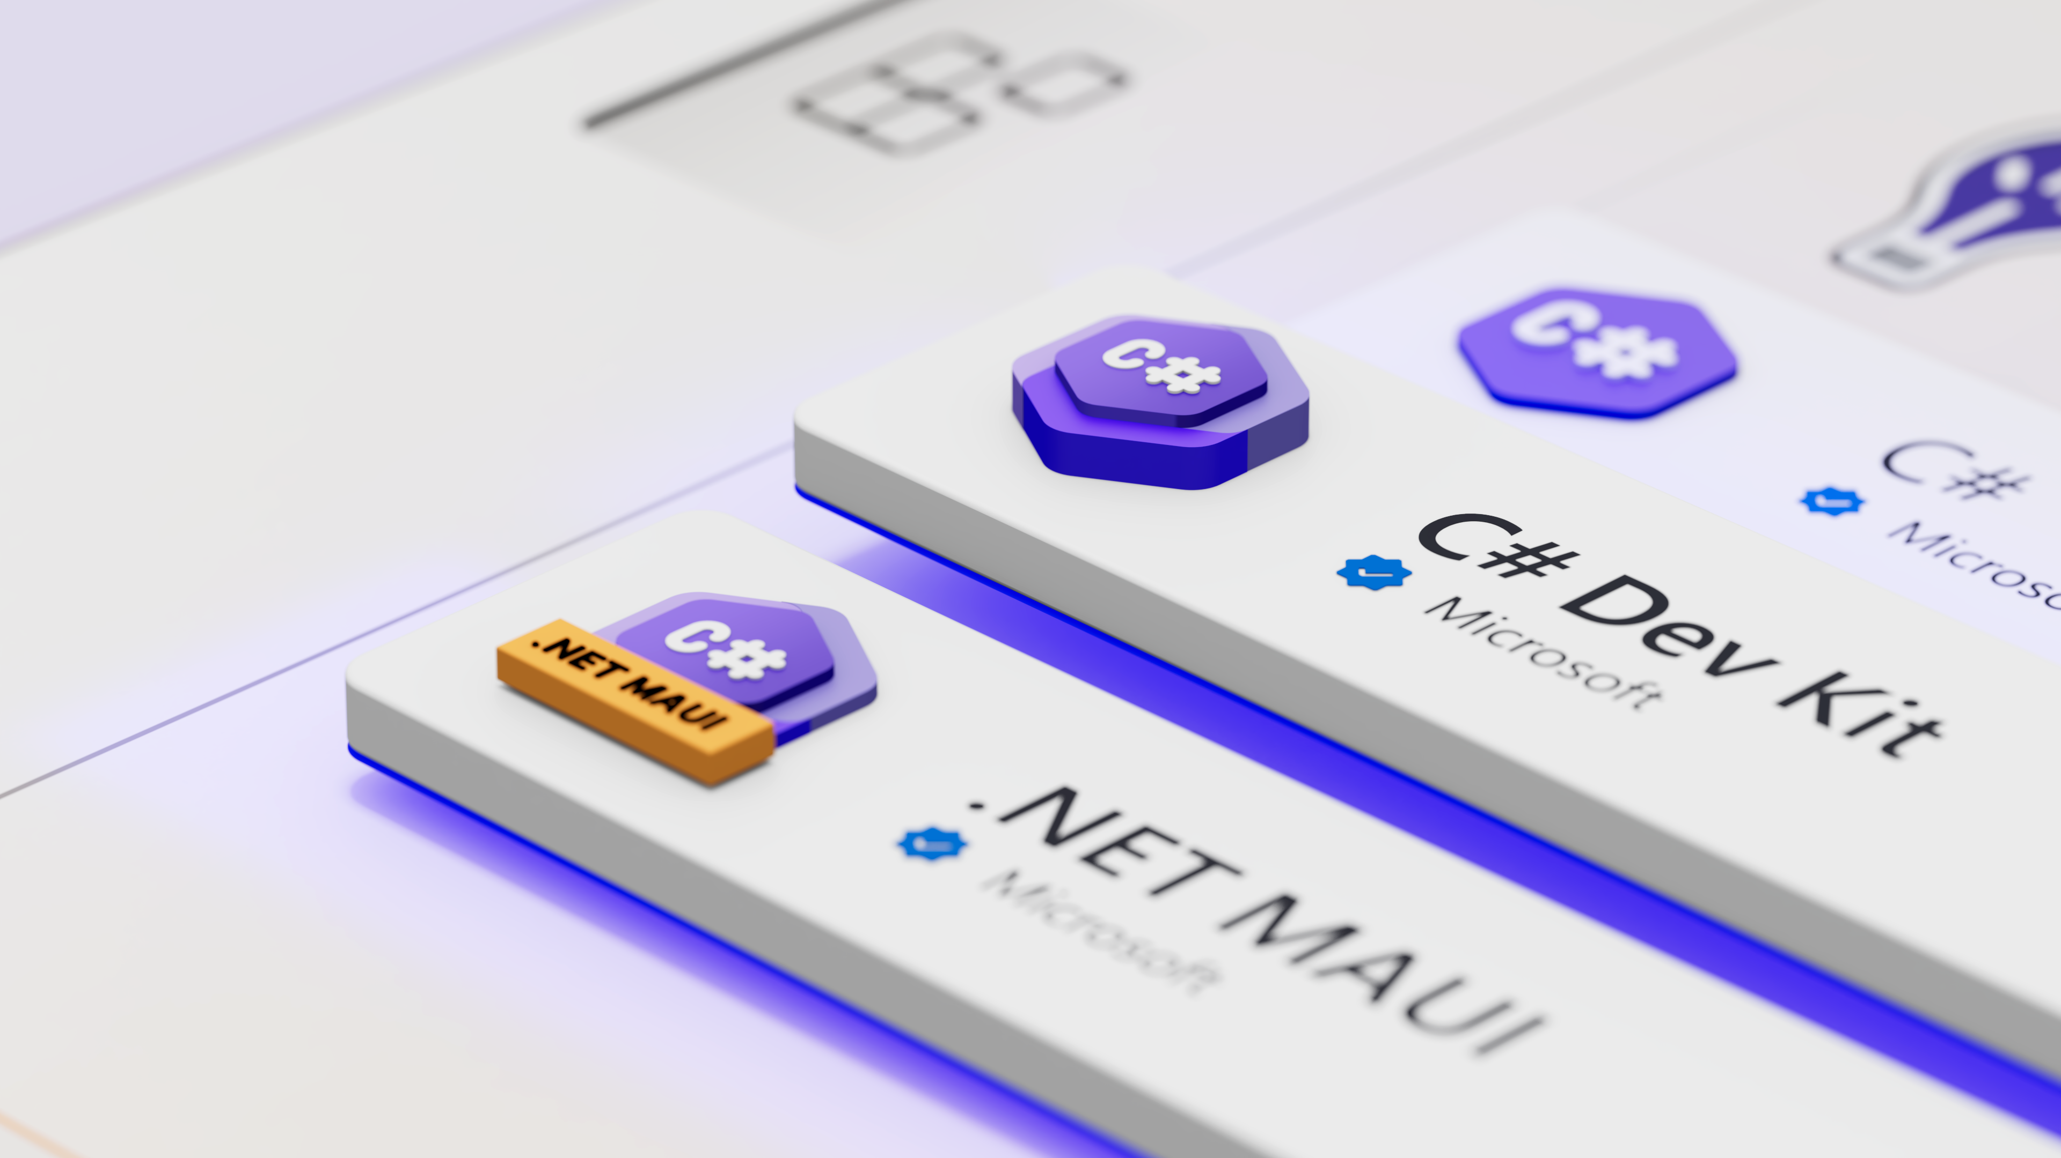
aka.ms/csdevkit
aka.ms/mauidevkit
Notes:
Everything Dave just showed you was using the new .NET MAUI extension in VS Code, which we also showed in the keynote earlier, but don’t worry IDE fans – we are still investing plenty in VS

Slide 23
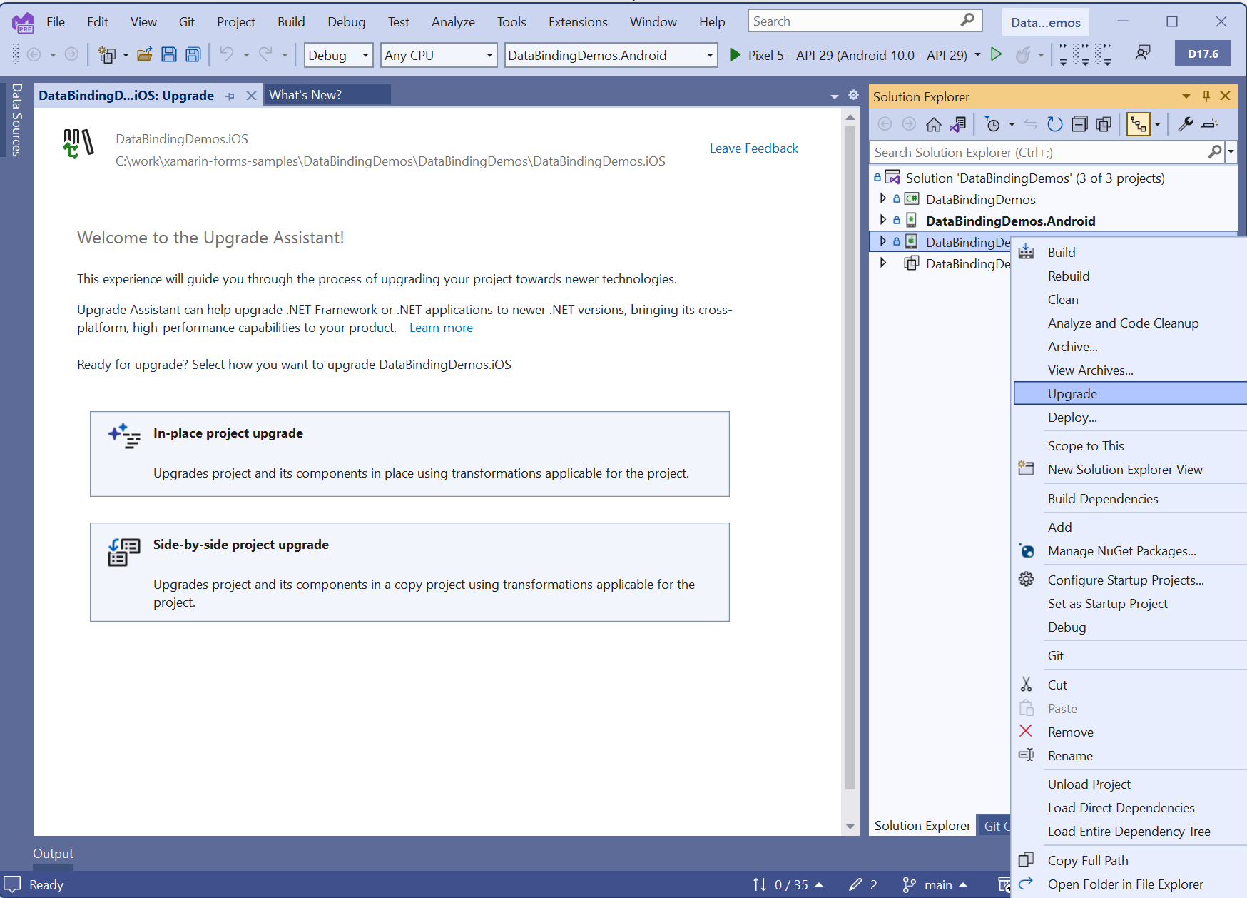
.NET Upgrade Assistant for Xamarin Projects
Highlights:
Converts projects
Replaces known NuGets
Fixes namespaces
Fixes base types
Applies various code updates
Also can help you upgrade from .NET 6/7 to .NET 8!
maui-upgrades@microsoft.com
Notes:
https://devblogs.microsoft.com/dotnet/upgrade-assistant-general-availability/#upgrades-from-xamarin-forms-to-net-maui

Slide 24
.NET 9

Slide 25
Lots of Goals
Increase delivery velocity of bug fixes
Reduce build times
Improve runtime performance
Support more native desktop experiences
Improve hot reload
Swift Interop
Add more documentation and samples
https://github.com/dotnet/maui/discussions
Notes:
DAVE

